Slide 1
Software Management Process Groups
By
Humaira Afzal
Lecturer CS, CUI Lahore Campus

Slide 2
Project Management process
“Project management processes ensure the effective flow of the project through its life-cycle.“

Slide 3
Project Management Process Groups
The project management process groups include:
Initiating
Planning
Executing
Monitoring and controlling
Closing

Slide 4
Initiating Processes Group
This is where the project is formally authorized by the sponsor, the initial scope is defined, and stakeholders are identified.
Activities:
Initial scope is defined.
Initial financial resources are committed
Internal and external Stakeholders are identified.
If not already assigned, the project manager will be selected.
This information is captured in the project charter and stakeholder register.

Slide 5
Initiating Process Group
Processes:
The Initiation process group has only two processes
Develop Project Charter
Identify Stakeholders
Key artifacts created:
Project Charter and Stakeholder Register.
Decision: Continue/delay/stop
Continue -> PM is given authorization to use resources to continue the project

Slide 6
Planning process Group
The Planning processes develop the project management plan and the project documents that will be used to carry out the project.
Activities of the phase include
Develop a strategy and a course of action to achieve the project objectives.
Gather information about the project and refine the plan of action.
Key documents created: Project Management Plan and project documents including work break down structure, schedule and cost baselines, risk registers , communication plan…

Slide 7
Project Planning processes
Plan scope management
Plan schedule management
Plan cost management
Plan quality management
Plan resource management
Plan communications management
Plan risk management
Plan procurement management
Plan stakeholder management
Identify risks
Perform qualitative risk analysis
Develop a project management plan
Collect requirements
Define scope
Create a work breakdown schedule
Define activities
Sequence activities
Estimate activity durations
Develop schedule
Estimate costs
Develop budget
Estimate activity resources
Perform quantitative risk analysis
Plan risk responses

Slide 8
Executing Process Group
The Executing Process Group consists of those processes performed to complete the work defined in the project management plan to satisfy the project specifications.
Activities include:
Coordinating people and resources
Managing stakeholders expectations
Performing the project plan tasks
During project execution, results may require planning updates and rebase lining… updating the project plan .

Slide 9
Project Executing - Processes
Manage project knowledge
Manage quality
Manage team
Manage communications
Manage stakeholder engagement
Direct and manage project work
Acquire resources
Develop team
Implement risk responses
Conduct procurements

Slide 10
Monitoring and Controlling Process Group
Involves measuring progress toward project objectives, monitoring deviation from the plan, and taking corrective actions.
Activities include:
Monitor project activities and compare them to the planned activities
Apply corrective or preventive actions
Control changes to the project.
Outputs include performance reports, change requests, and updates to plan.

Slide 11
Monitoring and Controlling - Processes
Monitor and control project work
Monitor communication
Monitor risk
Monitor stakeholder engagement
Control scope
Control schedule
Control cost
Control quality
Control resources
Control procurements
Validate scope
Perform change control

Slide 12
Closing Process Group
Processes to conclude the project activities and formally complete the project
It includes verification that all tasks are completed and deliverables are accepted by the stakeholders.
Outputs include project archives and lessons learned, part of organizational process assets
Most projects also include a final report and presentation to the sponsor/senior management.

Slide 13
Project Closing - Processes
1 - Close Project or Phase

Slide 14
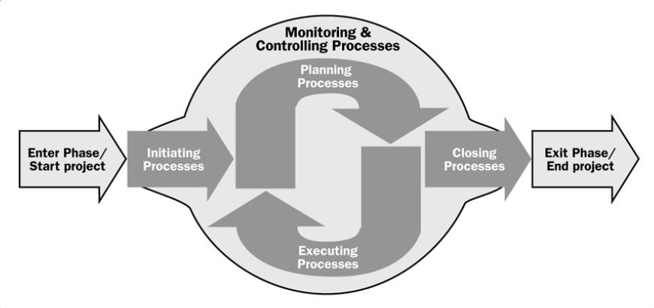
Project Management Process Groups

Slide 15
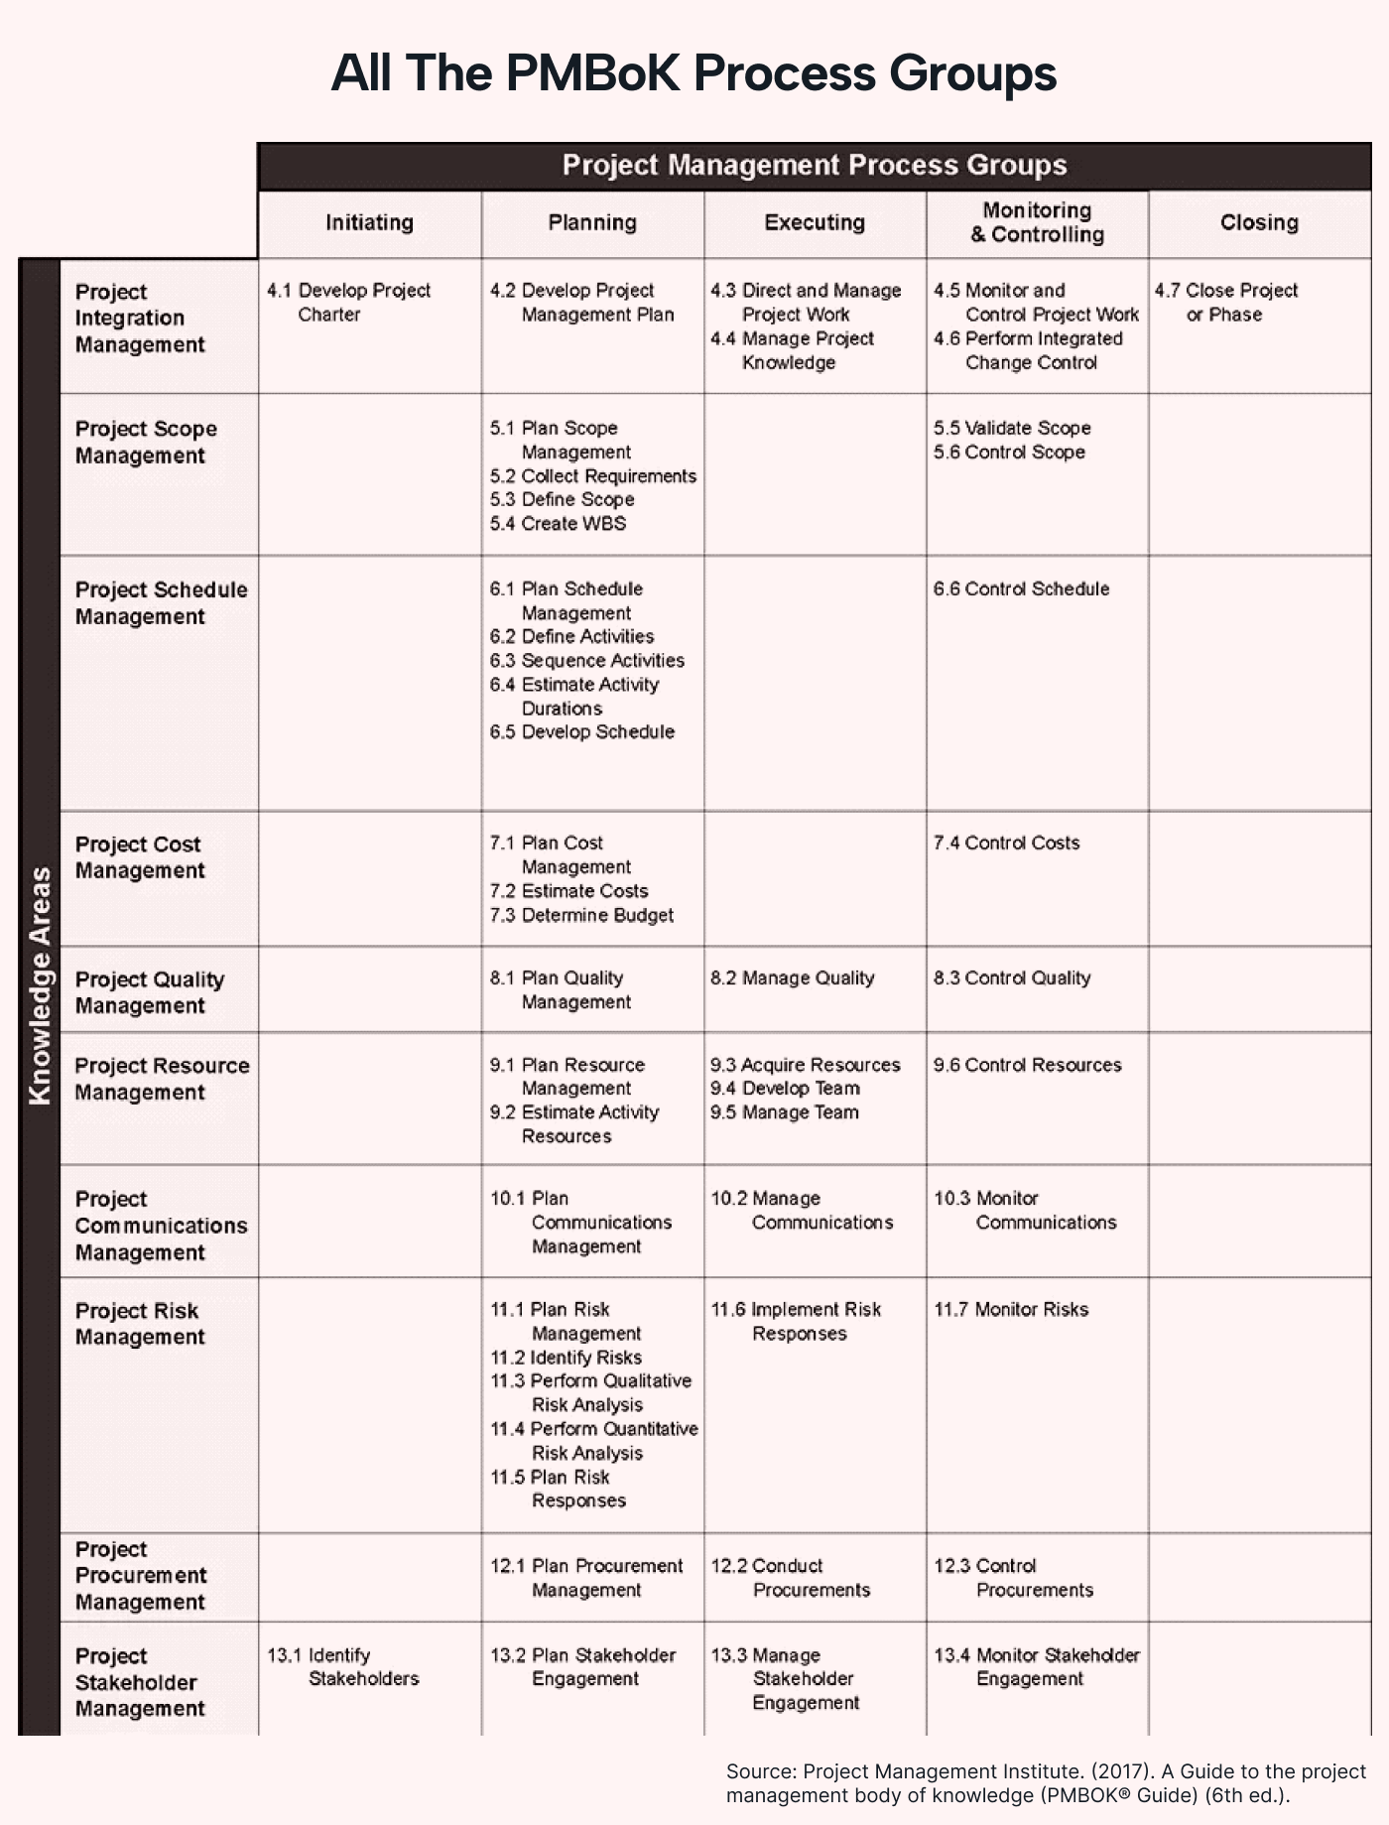

Slide 16
